Slide 1

TFMM Online Meeting: 10-12 May 2021
General update of MSC-E work
on heavy metals and POPs
I. Ilyin, O. Travnikov, A. Gusev, N. Batrakova, V. Shatalov

Slide 2
Outline
Analysis of trends
  PAH pollution trends and key sectors
  Analysis of Hg and POP pollution trends
  Marine pollution trend assessment
Arctic pollution assessment
Improvements of GLEMOS modelling system
Long-range transport of microplastics
TFMM Online Meeting: 10-12 May 2021

Slide 3
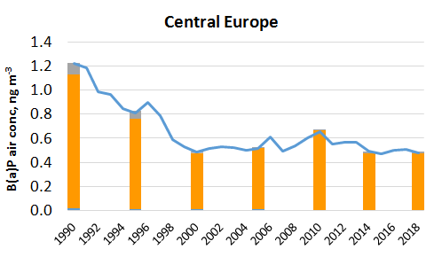
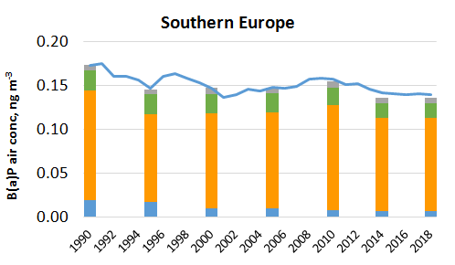
PAH pollution trends and key sectors
Contribution to analysis of POP Protocol effectiveness in co-operation
with TFTEI, TFH (workplan 1.1.1.1)
Long-Term Strategy for the Convention (2020-2030):
“unintentional releases of PAHs are still a concern”
“continue scientific research on POP transport and trends with a focus on PAHs”
Main activities:
Assess long-term changes of PAH pollution in the EMEP countries (1990-2018)
Estimate contributions of residential combustion and other sectors to PAH pollution
Research activities to improve PAH pollution assessment (Case study, EuroDelta-Carb)
Contribute to assessment of human exposure to particulate matter and toxic PAHs
Industry
Res Comb
Agriculture
Other
TFMM Online Meeting: 10-12 May 2021

Slide 4
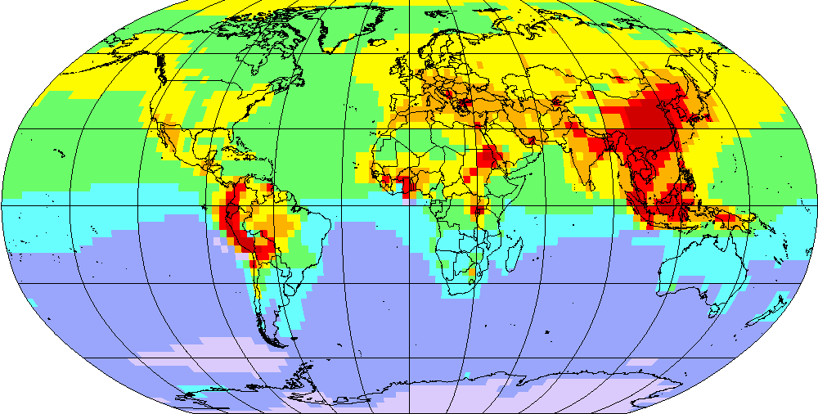
Analysis of Hg and POP pollution trends
Attribution of long-term trends to various factors (co-operation with TF HTAP)
Motivation:
Explain long-term pollution changes in the EMEP and other regions
Isolation of the effect of regional emission reduction from other factors
Hg⁰ concentration
Analyzed factors:
Changes in emissions of EMEP countries
Long-range transport from other regions
Variation of meteorological conditions, climate change
Changes in redox chemistry
Hg⁰ air concentration in Europe
n = 22
Measurements
Model
TFMM Online Meeting: 10-12 May 2021

Slide 5
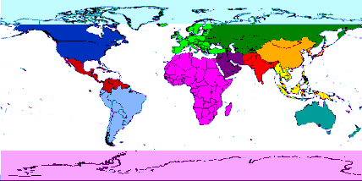
Trends attribution
Contribution of source regions to Hg⁰ concentration in Europe and the Arctic
30% reduction
7% reduction
Source regions
Europe
East Asia
North America
Other
South Asia
Natural & legacy
Emission reduction in Europe is partly balanced by emissions increase
in East Asia and slowly changing legacy emissions
TFMM Online Meeting: 10-12 May 2021

Slide 6
Factors affecting long-term trends
Contribution of various environmental factors to relative change of Hg⁰ concentration
30% reduction
7% reduction
Total reduction
Meteorology / climate
Others
Anthropogenic emissions
Chemical reactants
Effect of other factors is more pronounced in remote regions with insignificant local emissions
TFMM Online Meeting: 10-12 May 2021

Slide 7
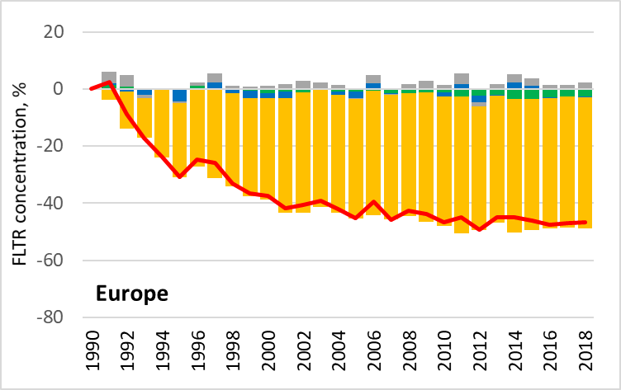
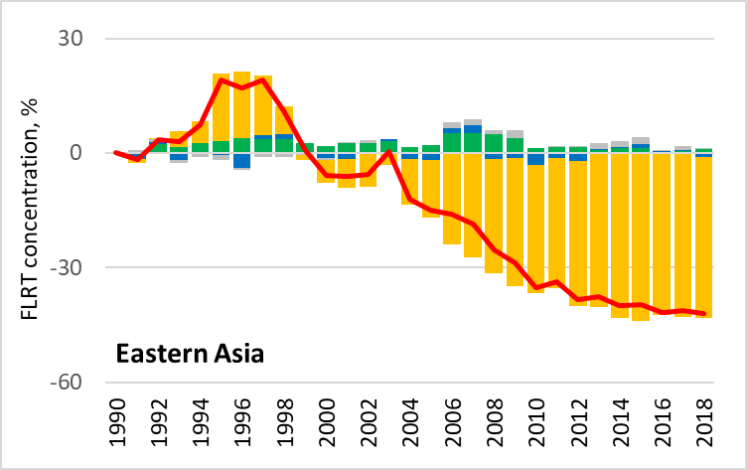
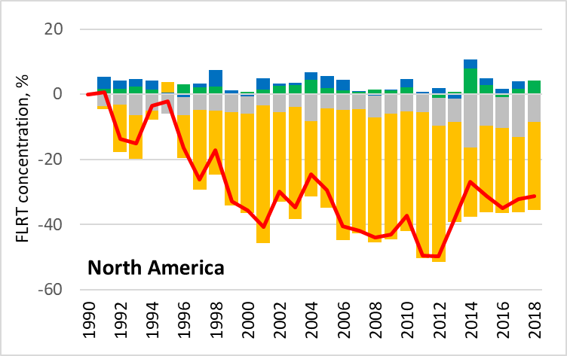
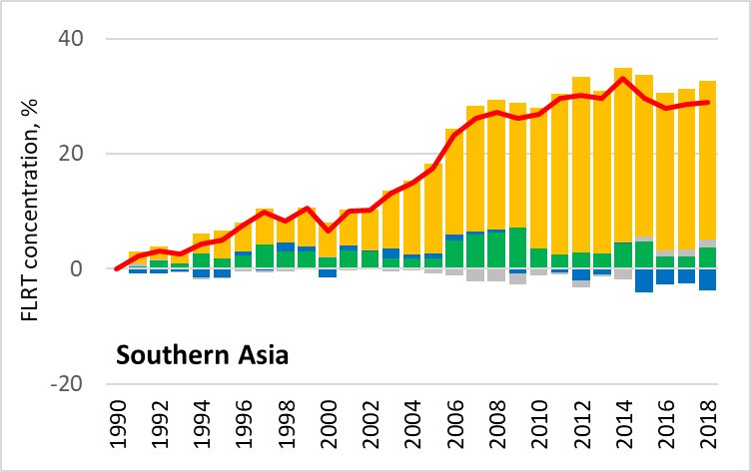
Attribution of PAH pollution trends: analysis of factors
Contribution of various factors to relative changes of Fluoranthene concentrations
in HTAP regions (preliminary GLEMOS model results based on PKU-PAH emissions)
Total change
Anthropogenic emissions
Meteorology / climate
Chemical reactants
Others
TFMM Online Meeting: 10-12 May 2021

Slide 8
TF HTAP analysis of trends and source attribution
Workshops on Hg (13 April, 2021) and POP (15 April, 2021)
About 60 participants at each workshop
Main purpose:
Initiate research activities to support the expected review of HM and POP protocols.
Further tasks:
Compilation of emission and measurement data for trend analysis
Analysis of trends and source attribution (including Multi-Model Comparison and Evaluation)
Future Hg, POPs and CEC levels based on emissions scenarios
Uncertainty Analysis
Emissions
inventory
Monitoring
Modeling
TFMM Online Meeting: 10-12 May 2021

Slide 9
TF HTAP analysis of trends and source attribution
Modelling groups planning to participate
Organizations | Models | Pollutant
CNR-IIA (Italy) | ECHMERIT | Hg
Harvard University (USA) | GEOS-Chem | Hg
Harvard University (USA) | GBC-boxmodel (box model, multi-media) | Hg
HZG (Germany) | MECOSMO (Oceanic) | Hg
Environment and Climate Change Canada (Canada) | GEM-MACH-Hg | Hg
MIT (USA) | GEOS-Chem | Hg, POPs
EMEP/MSC-E | GLEMOS | Hg, POPs
PKU, China | CanMETOP | POPs
Center for Environmental Risk Research, Japan | FATE | POPs
Environment and Climate Change Canada | GEM-MACH-PAH | POPs
National Environmental Research Institute, Denmark | DEHM-POP | POPs
TFMM Online Meeting: 10-12 May 2021

Slide 10
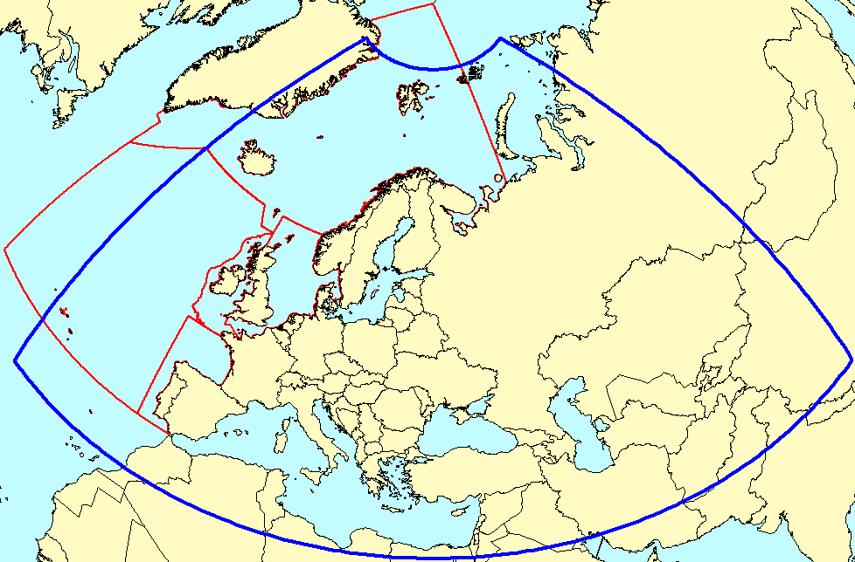
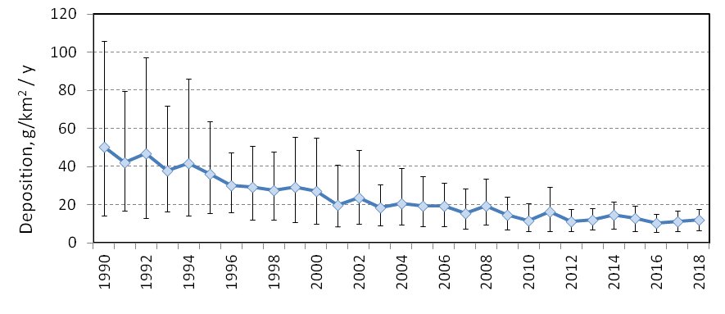
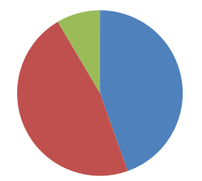
Trend assessment of marine pollution by HMs and POPs
Ad-hoc group on marine pollution (Bureau meeting March, 2021)
Focus of regional marine conventions (OSPAR, HELCOM, Barcelona, Black Sea, EU Marine Strategy Framework Directive…. )
On-going activity: assessment of atmospheric loads to OSPAR maritime regions
OSPAR regions and EMEP domain
Model assessment of long-term trends of heavy metal deposition to the North Sea and Northern Atlantic
Source-receptor matrices of HM deposition to the OSPAR regions
Considered pollutants – Cd, Pb, Hg
I
V
III
II
IV
Cd deposition to the North Sea
Source attribution (Cd, North Sea, 2019)
Anthropogenic
Secondary (marine aerosol)
Non-EMEP sources
The project is funded by OSPAR
TFMM Online Meeting: 10-12 May 2021

Slide 11
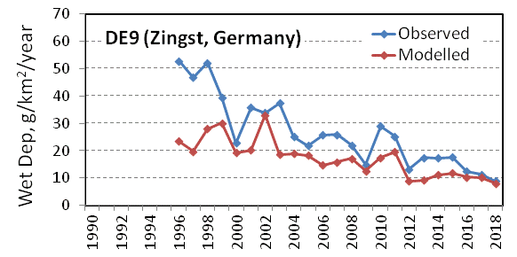
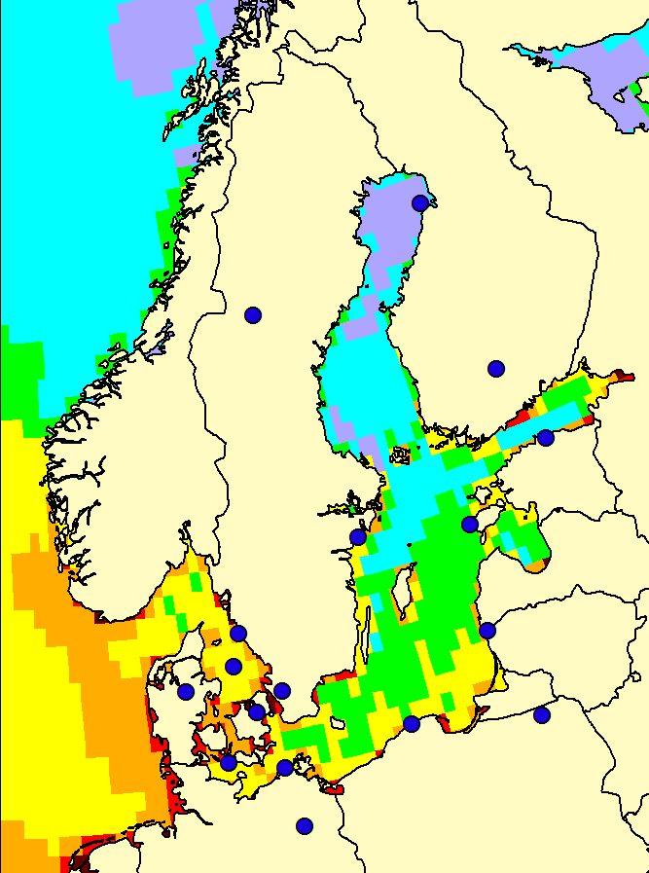
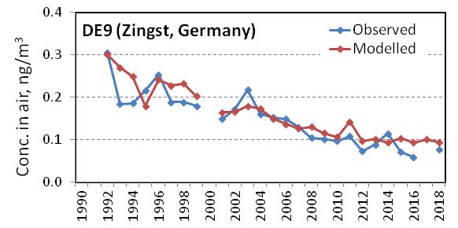
Trend assessment of marine pollution by HMs and POPs
Model assessment of atmospheric loads to the Baltic Sea (cooperation with HELCOM)
Long-term trends
Source apportionment
Evaluation against measurements
Considered metals: Pb, Cd, Hg, Cu
Considered POPs: PAHs, PCB, PCDD/Fs, HCB, PFOS, PBDE, SCCP, PCN, PeCBz, HBCDD
Cd deposition, 2018
DE9
5
7
10
15
20
25
g/km²/y
The project is funded by HELCOM
- HELCOM stations
TFMM Online Meeting: 10-12 May 2021

Slide 12
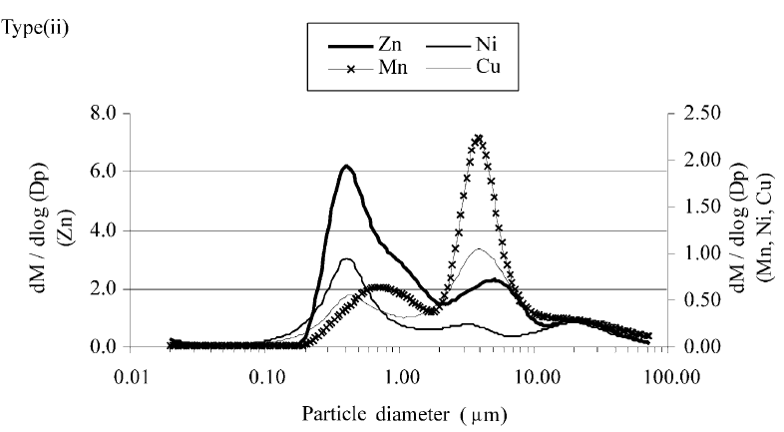
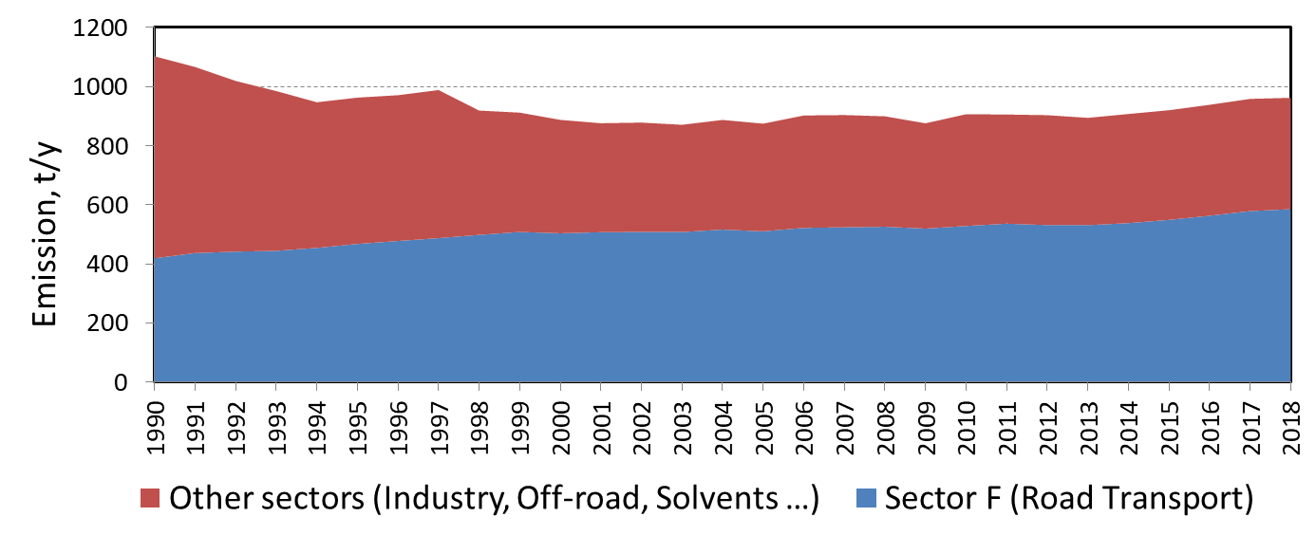
Trend assessment of marine pollution by Cu
Model assessment of second-priority heavy metals (Cu) in cooperation with HELCOM
EMEP station GB48
Toxic effects (excess of Cu): degradation in soil quality and plant growth, health effects
Bi-modal size distribution of aerosol particles – carriers
High contribution to emission from Road Transport (Sector F, brake/tire wear)
Low emission reduction over the last decades
Allen et al, 2001, Atm. Env., 35 4581–4591
Cu official emission in the HELCOM countries
Sector F: 40 – 60%
TFMM Online Meeting: 10-12 May 2021

Slide 13
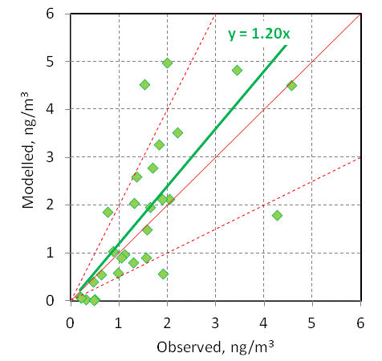
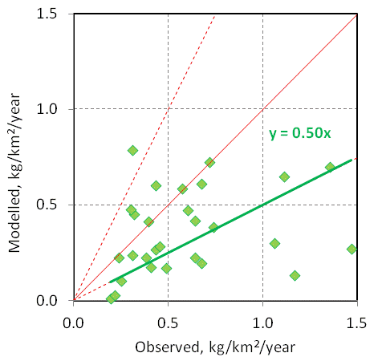
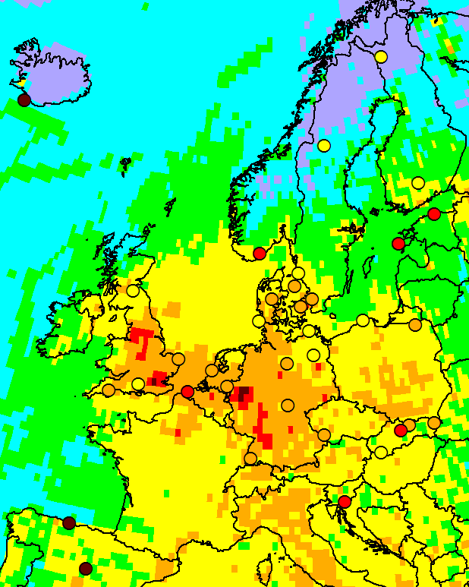
Trend assessment of marine pollution by Cu
Modelled vs. observed Cu levels: pilot results (2018)
Air concentrations
Wet deposition
Cu wet deposition, 2018
Mean Bias = +25%
Mean Bias = -40%
Good fit for air concentrations
Underestimation for wet deposition
Further focus on the model parameterizations; quality of emissions and measurements
0.02
0.05
0.15
0.5
1.5
3
kg/km²/y
TFMM Online Meeting: 10-12 May 2021

Slide 14
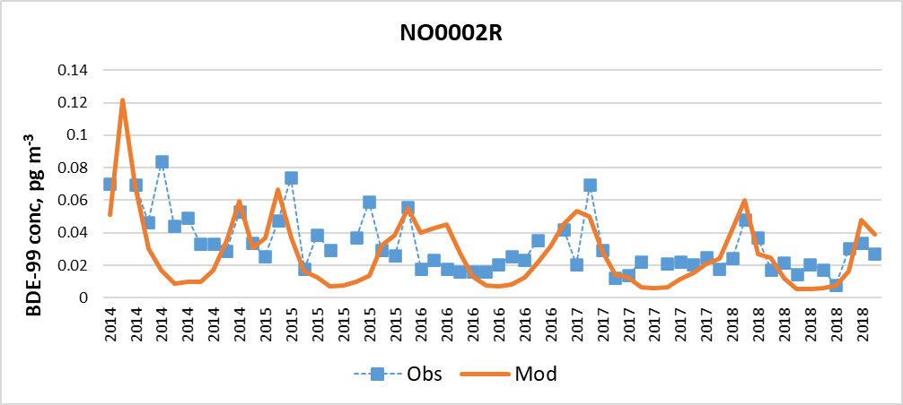
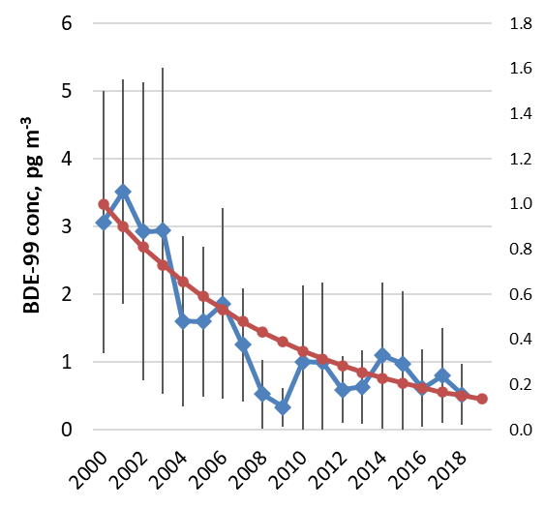
Trend assessment of marine pollution by POPs
POPs: PAHs, PCB, PCDD/Fs, HCB
Contaminants of emerging concern: PFOS, PBDE, SCCP, PCN, PeCBz, HBCDD
Long-term changes in BDE-99 deposition for 2000-2018
Polybrominated diphenyl ethers (PBDEs) are a group of persistent toxic chemicals used as flame retardants
Concentration of indicator congener BDE-99 measured in UK, Finland and Norway declined by 5 – 15-fold from 2000 to 2018
Experimental modelling of BDE-99 based on TNO emissions and expert estimates
Observed BDE-99 concentrations and relative decline of emission (2000-2018)
Emission decline
Observed and modelled BDE-99 concentrations
TFMM Online Meeting: 10-12 May 2021

Slide 15
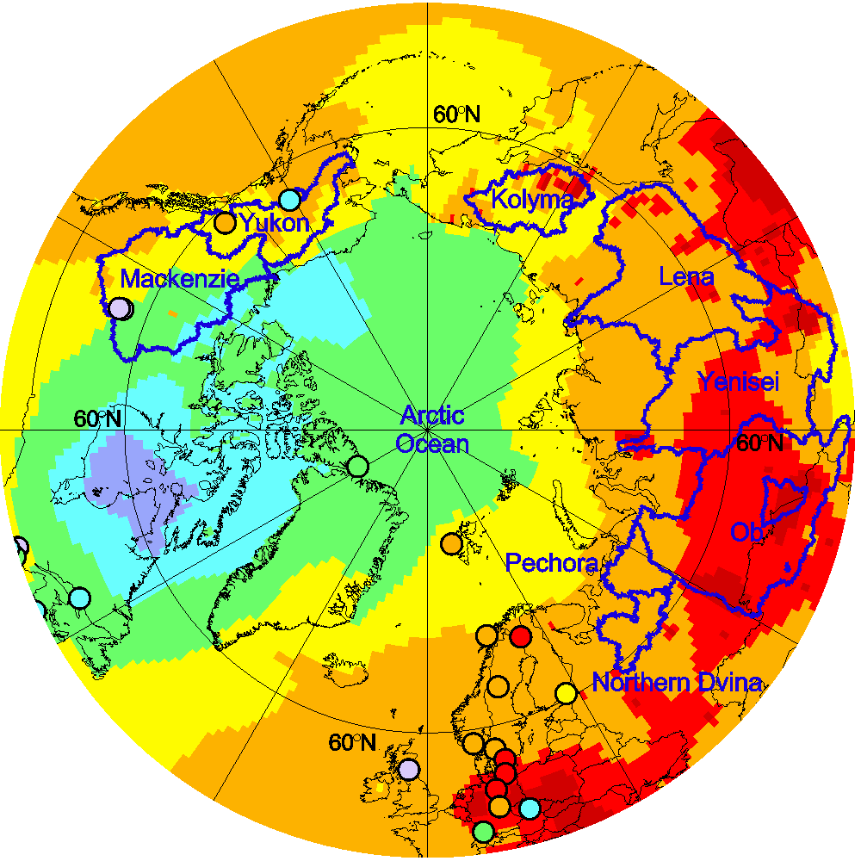
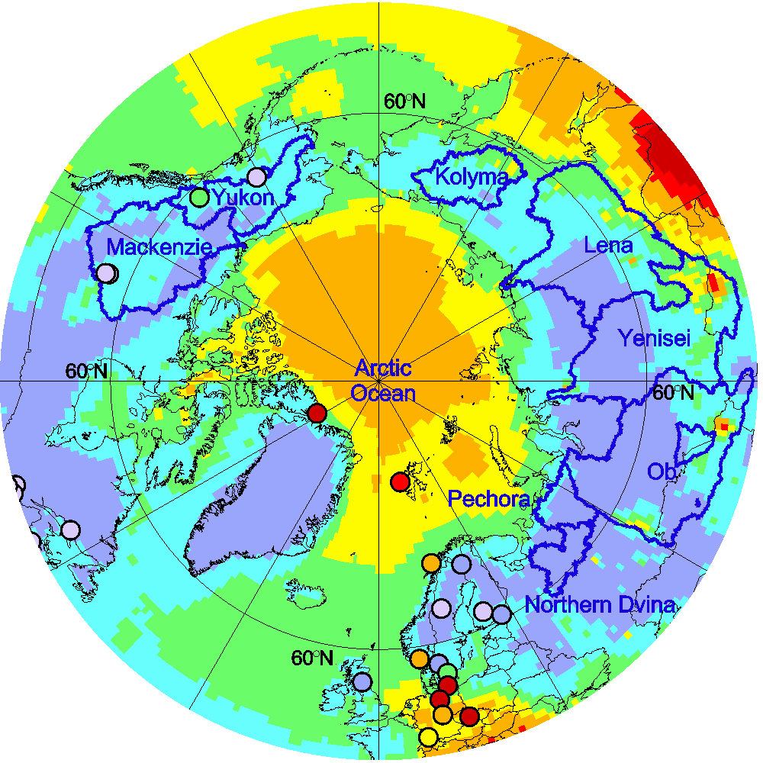
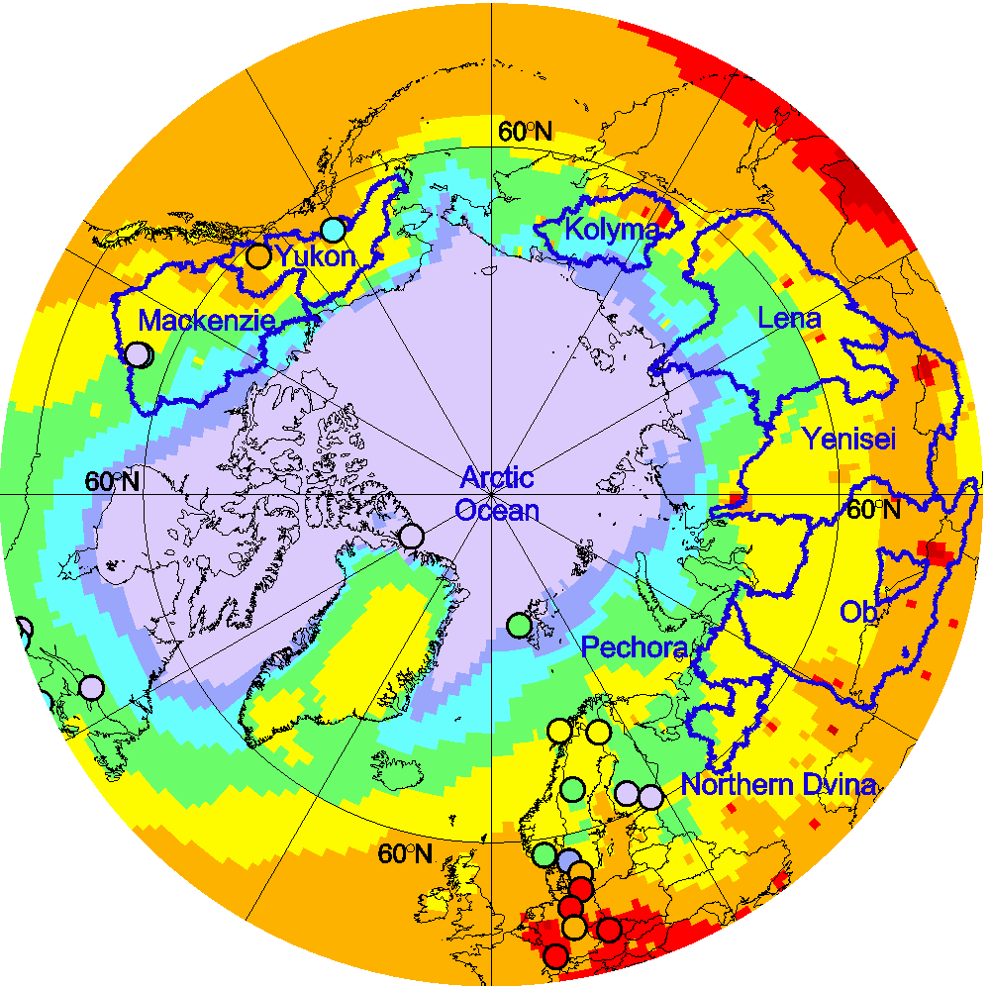
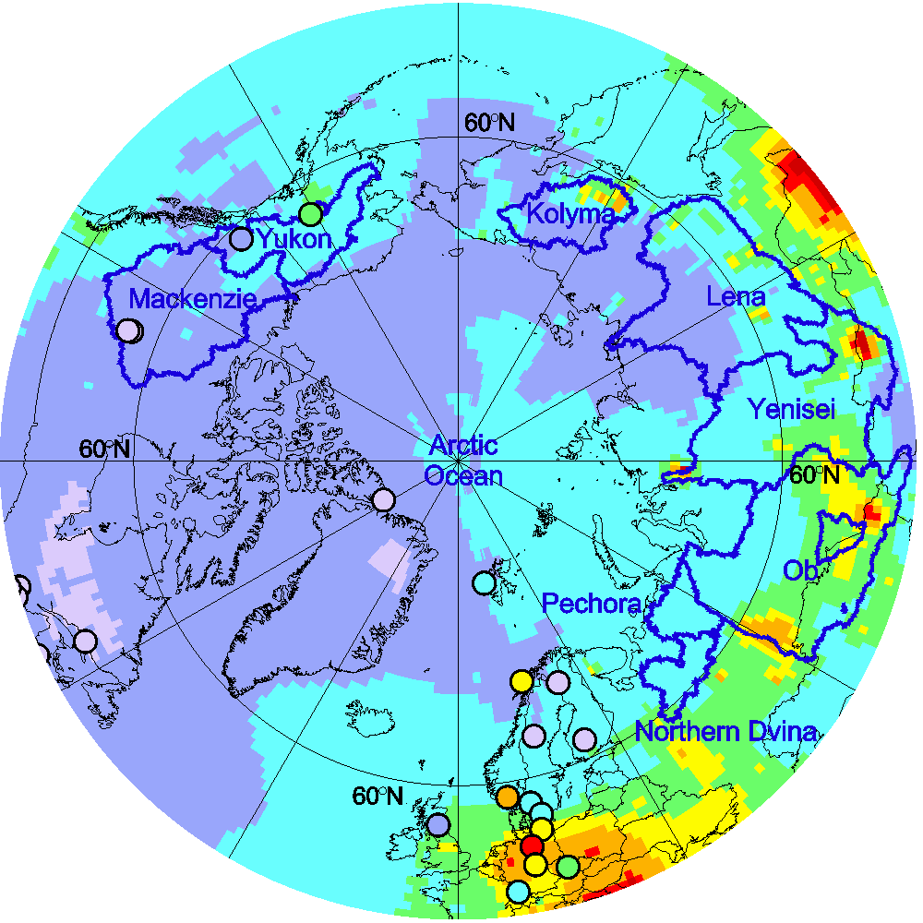

Arctic pollution assessment
EMEP contribution to the AMAP Hg Assessment 2021
Hg⁰ air concentration in the Arctic
Model assessment:
Multi-model study by international research group (MSC-E, Canada, USA, Denmark)
Model estimates of Hg concentration and deposition over the Arctic
Source apportionment of Hg deposition to the Arctic sub-regions and large rivers watersheds
Balance estimates of Hg transport and accumulation in the Arctic
Winter
Summer
Spring
Autumn
To be released by May 2021
TFMM Online Meeting: 10-12 May 2021

Slide 16
Model development: Hg chemistry
Objective:
Analysis and evaluation of new Hg oxidation/reduction mechanisms in the atmosphere
General scheme of Hg redox chemistry
hν
Br, OH, HO₂, NO₂, …
hν
Br
Hg^{I}Br
Hg^{II}
Hg⁰
OH
hν
Hg^{I}OH
HO₂, NO₂, …
hν
Recent activities:
Collaborative study by international research group (EMEP/MSC-E, Spain, France, USA, Canada, UK, Germany)
A new photo-reduction schemes were developed and tested. The results published in PNAS (Saiz-Lopez et al., 2020)
Currently, a mechanism of Hg⁰ heterogenic oxidation is studied
Simulated Hg^{II} concentration
Model
Saiz-Lopez et al. (2020)
Measurements
TFMM Online Meeting: 10-12 May 2021

Slide 17
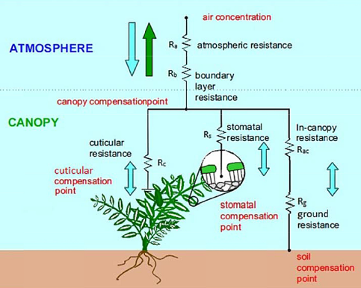
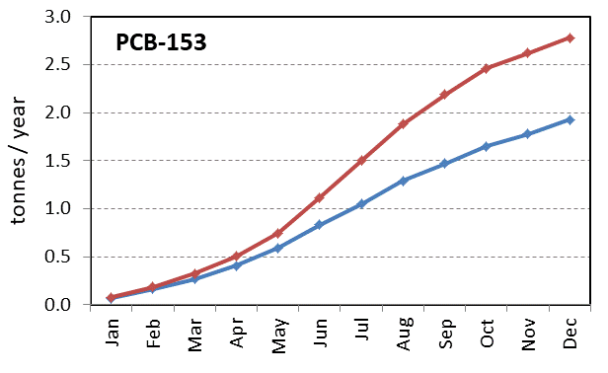
Model development: parameterization of air-surface exchange
Multi-media modelling approach to Hg and POPs
Previous scheme: air/soil and air/vegetation are considered separately
New scheme: unified air/soil/vegetation system:
Pilot results
New scheme of air–surface exchange
Dry deposition flux to the EMEP region
Previous
New
Sutton et al, 2007; Wang et al, 2014
The new scheme resulted in re-distribution of the exchange fluxes
Further testing of the scheme and comparison with observations is needed
TFMM Online Meeting: 10-12 May 2021

Slide 18
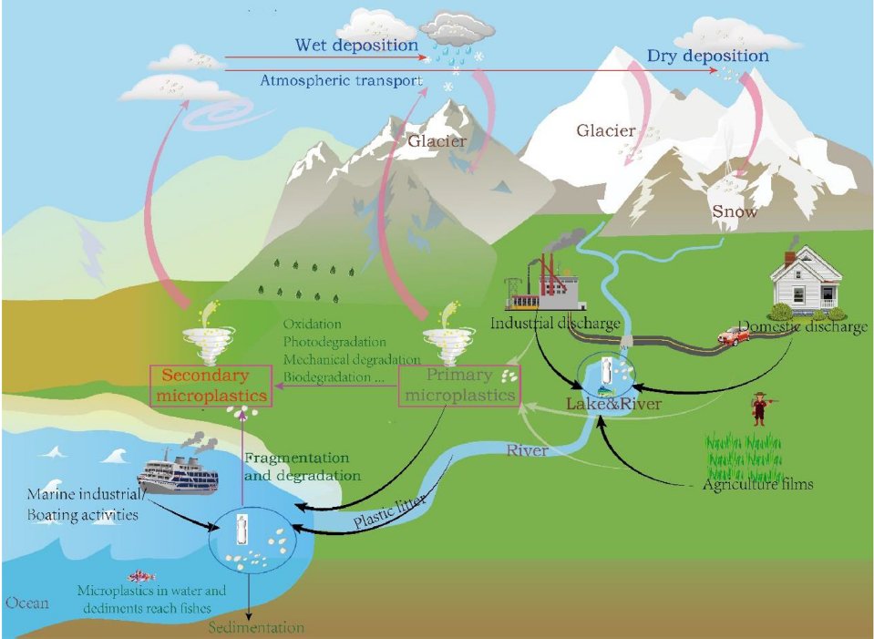
Long-range atmospheric transport of microplastics
Motivation
An emerging concern worldwide
Plastic itself (monomers) and its additives (pigments, dyes, plasticizers, PFAs, phthalates) lead to adverse health effects
Microplastics adsorb and accumulate pollutants (HMs, PAHs, PCBs, HCB)
Atmospheric transport may be important pathway for microplastics in remote regions
Main atmospheric sources
Re-suspension from sea and land surface, including:
  roads (tire wear)
  agriculture
  urban street dust
Environmental cycle of microplastics
Transport and deposition
Potential activities were discussed at:
EMEP/WGE Bureau meeting (March, 2021)
TF HTAP workshop on POPs (April, 2021)
Wind re-suspension
Zhang et al, 2019, Env. Poll.
TFMM Online Meeting: 10-12 May 2021

Slide 19
Topics for the discussion at split session on POP/HM/CEC/Microplastics
Aerosols/toxic compounds (understanding of sources)
  Carbonaceous aerosols and toxic compounds (PAHs, PCBs, etc.) from biomass burning and wildfires
  Update of re-suspension of wind-blown dust
  TFMM/EuroDelta-Carb multi-model study of B(a)P pollution
Case studies on assessment of pollution levels on country/regional scale
  Ongoing case study for Poland
  Case study on Hg in Norway/Nordic countries
  HM/POP case studies for other countries
Analysis of long-term trends, including:
  Regional seas
  Arctic
  Attribution of global scale long-term trends for Hg/POP (coop. with TF HTAP)
New contaminants and microplastics
  Assessment of second priority metals (e.g., Cu) and chemicals of emerging concern
  (PFOS, PBDE, SCCP, PCN, PeCBz, HBCDD)
  Preparatory work to explore long-range transport potential of microplastics
TFMM Online Meeting: 10-12 May 2021

